Slide 1


AI Chatbots for Student Support & Services
Transforming campus inquiries into instant, personalized, 24/7 engagement through conversational intelligence.

Slide 2

The Student Support Crisis
Traditional university helpdesks face growing inquiry volumes, fragmented departmental knowledge, and off-hour response bottlenecks.

Slide 3

Traditional vs. AI Support
Legacy University Desk
AI Conversational Support
Limited operating hours lead to long email wait queues. Administrative staff burn out repeating answers to routine queries regarding tuition, registration, and deadlines.
Instant 24/7 multi-channel responses across web, mobile app, and SMS. Seamless escalation routes complex empathetic cases directly to human advisors.

Slide 4

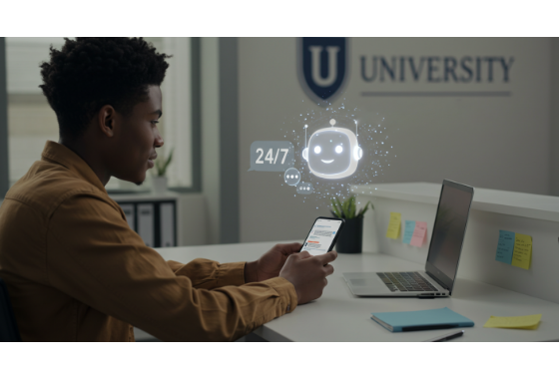
Core Chatbot Capabilities
24/7 Instant Inquiry Resolution: Resolves standard queries about financial aid, campus housing, and course schedules in seconds.
Multi-Language Support: Automatically translates conversations to assist international and ESL students.
System Integration: Connects directly with SIS, LMS (Canvas/Blackboard), and CRM databases securely.
Context-Aware Guidance: Delivers hyper-personalized answers based on the student's program and standing.

Slide 5






Key Institutional Use Cases
Admissions & Aid
Academic Support
Campus Life & Admin
Guides prospective students through application steps, financial aid documents, scholarship deadlines, and tuition payment plans.
Assists with course registration, advisor scheduling, tutoring appointments, and syllabus knowledge retrieval.
Answers housing requests, campus navigation, IT password resets, health services info, and facility operating hours.

Slide 6

Impact & Performance Metrics
Measurable Institutional Benefits
Deploying AI student support chatbots reduces helpdesk operational costs while increasing student satisfaction scores. Institutions see up to a 60% boost in overall student engagement and significantly reduced administrative backlog during peak enrollment periods.
85%
Routine Queries Automated

Slide 7
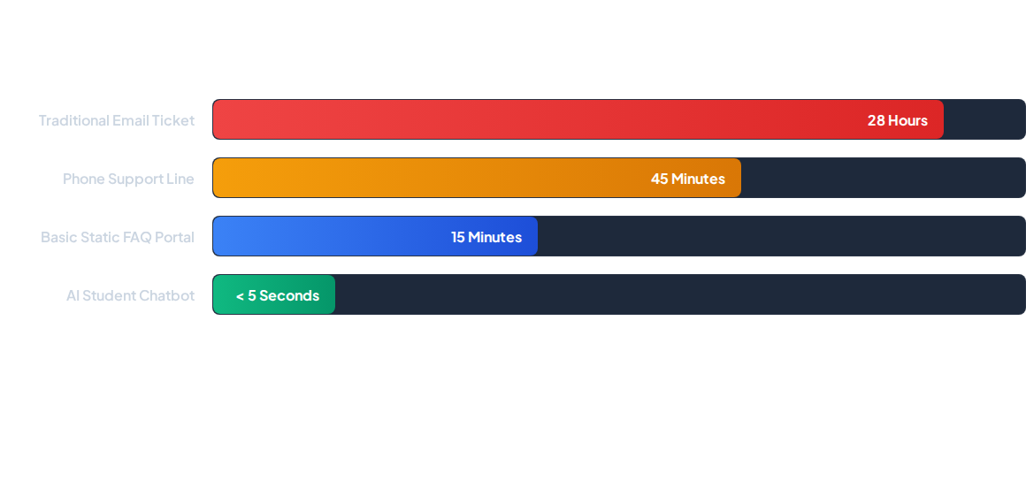
Response Time & Resolution
AI chatbots drastically cut down response latency from hours to milliseconds, enabling instant student relief and reducing administrative friction.

Slide 8




Implementation Roadmap
Phase 2: Train
Phase 4: Scale
Configure RAG & LLM parameters using university regulations, policies, and tone guidelines.
Roll out across all university departments with continuous analytics and feedback loops.
Phase 1: Audit
Phase 3: Pilot
Aggregate institutional knowledge bases, campus FAQs, and identify key integration endpoints.
Launch targeted pilot for high-demand areas like Admissions or Financial Aid before full deployment.

Slide 9

Proactive Student Success
Beyond answering inbound queries, generative AI chatbots utilize predictive analytics to trigger timely nudges for upcoming tuition deadlines, advising milestones, and class registration dates.
This proactive engagement helps institutions boost retention rates and ensure early interventions for at-risk students.

Slide 10

Platform Feature Matrix
Feature Dimension | Static Web FAQ | Rule-Based Bot | AI GenAI Chatbot
Availability & Speed | 24/7 (Self Service) | 24/7 (Instant) | 24/7 (Instant & Adaptive)
Contextual Understanding | None | Keywords Only | Deep Natural Language
Personalized Data Access | No | Rare | Integrated (SIS/LMS)
Proactive Student Nudges | No | No | Automated Alerts

Slide 11
Transforming Engagement
"
AI empowers institutions to convert reactive administrative support into a proactive, personalized student success engine.
"
— Higher Education Technology Council

Slide 12
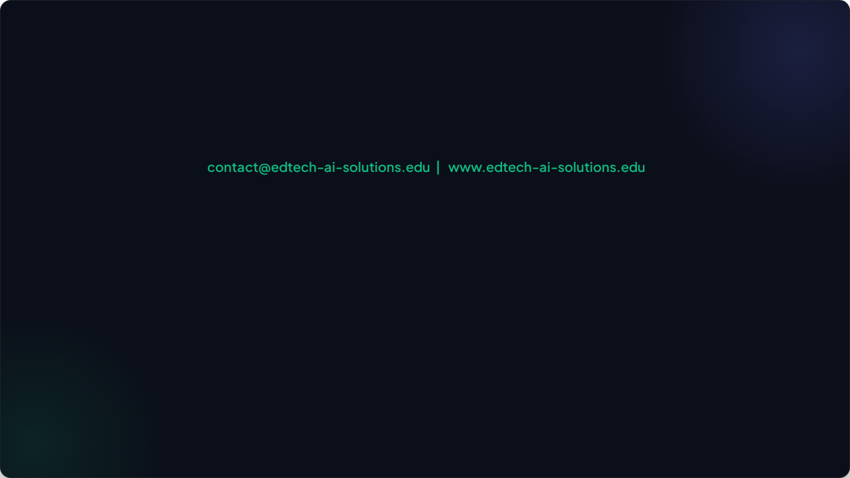
Questions & Next Steps
Ready to modernize student services at your university?

Slide 13


Image Sources
https://edutech.global/wp-content/uploads/2025/09/BLOG-25_HERO-IMAGE.png
Source: edutech.global
https://wellfleetstudent.com/wp-content/uploads/2023/11/AdobeStock_536953236_resize-1.png
Source: wellfleetstudent.com

